Slide 1

From BB84 to ‘CT23’: A brief history of QKD methodology

Slide 2
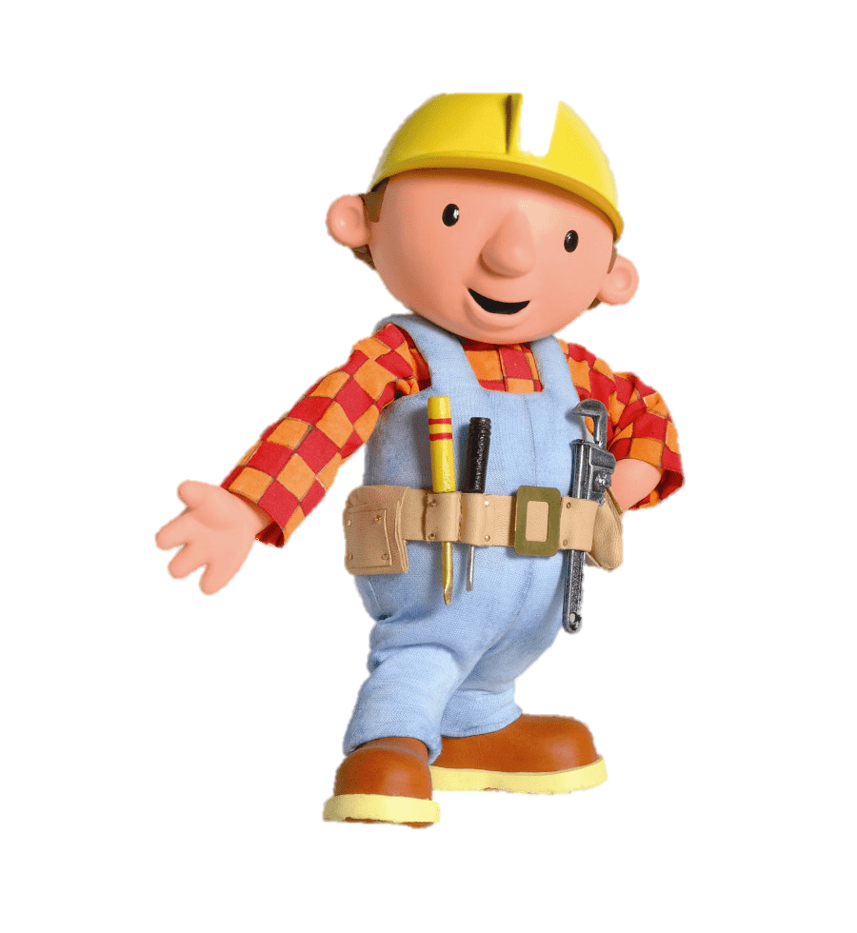
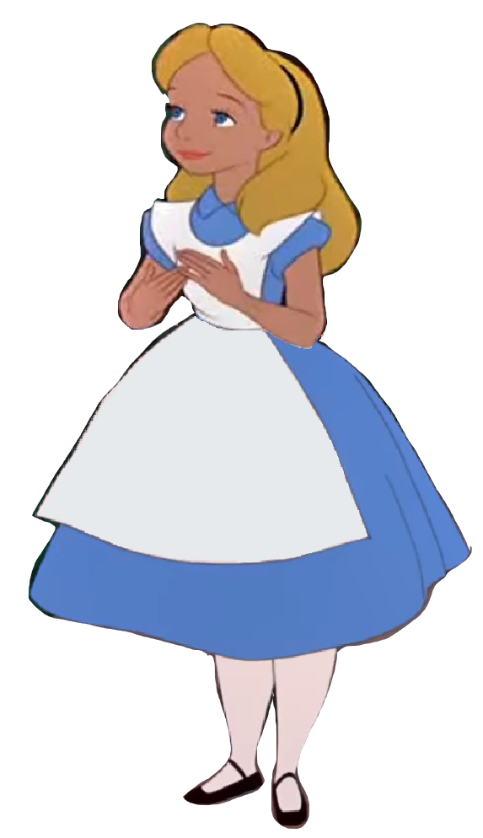


Your average QKD protocol
Quantum States
Alice
Bob
LOPC
...
$$K_{A}$$
$$K_{B}$$

Slide 3
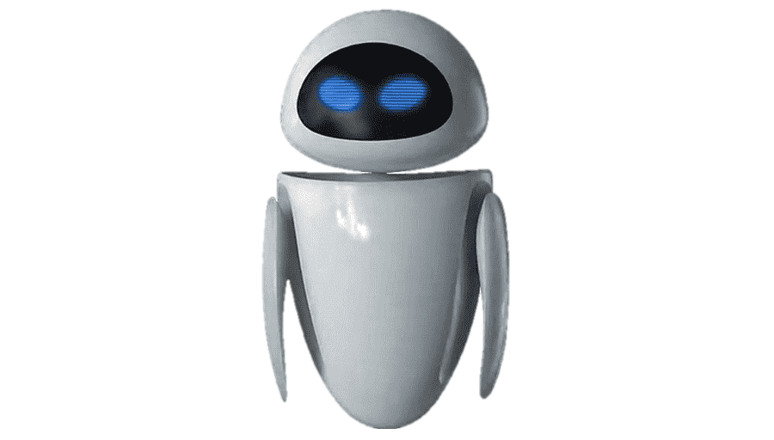
Your average QKD protocol
Quantum States
Alice
Bob
LOPC
...
$$K_{A}$$
$$K_{B}$$

Slide 4
Chronology of QKD
1984-1991
2023
2003
2005
2006
2008
2018-2022

Slide 5








1984-1991: The BB84 protocol
$$|0⟩$$
$$\{|0⟩,|1⟩\}$$
$$\{|0⟩,|1⟩\}$$
$$|1⟩$$
$$|+⟩$$
$$\{|+⟩,|−⟩\}$$
$$\{|+⟩,|−⟩\}$$
$$|−⟩$$
Pick
basis
Send
state
Pick measurement
basis

Slide 6





1984-1991: The BBM92 protocol
$$\{|0⟩,|1⟩\}$$
$$\{|0⟩,|1⟩\}$$
$$\left|00\right\rangle +|11⟩$$
$$=$$
$$\left|++\right\rangle +|−−⟩$$
$$\{|+⟩,|−⟩\}$$
$$\{|+⟩,|−⟩\}$$
Pick measurement
basis
Pick measurement
basis

Slide 7
Chronology of QKD
1984-1991: BB84,E91, BBM92
2023
2003
2006
2018-2022
2008
2005

Slide 8
Problems:
How do you deal with the eavesdropper?
What if your channels/sources are noisy?
How about error-correction/post-processing?
How do you define security?
How many bits of key per measurement round (keyrate)?
Need a formalism!

Slide 9



A round of the BBM92 protocol
$$ρ_{ABE}$$
Alice
Bob
Selects $X←\{0,1\}$
If $X=0$ measure with $\{|0⟩,|1⟩\}$
If $X=1$measure with $\{|+⟩,|−⟩\}$
Output is $A∈\{0,1\}$
Selects $Y←\{0,1\}$
If $Y=0$ measure with $\{|0⟩,|1⟩\}$
If $Y=1$measure with $\{|+⟩,|−⟩\}$
Output is $B∈\{0,1\}$

Slide 10



After $N$ rounds of the BBM92 protocol
Alice has
Measurement inputs $X_{1}…X_{N}$
Measurement outputs $A_{1}…A_{N}$
Bob has
Measurement inputs $Y_{1}…Y_{N}$
Measurement outputs $A_{1}…A_{N}$

Slide 11

After $N$ rounds of the BBM92 protocol
Alice has
Measurement inputs $X_{1}…X_{N}$
Measurement outputs $A_{1}…A_{N}$
Bob has
Measurement inputs $Y_{1}…Y_{N}$
Measurement outputs $A_{1}…A_{N}$
Alice and Bob announce all measurement inputs and keep only the rounds with $X_{i}=Y_{i}$, say $n$ rounds remain.
Need to error-correct to ensure $A_{i}=B_{i}$, but this leaks information!
Need to bound the amount of information Eve has about the raw key $A_{1}…A_{n}$!

Slide 12

Quick entropy talk
Shannon entropy:
Given random variable $$X∼\{p_{x}\}_{x∈𝒳}$$
The Shannon entropy is: $$H{\left(X\right)}_{p}=−\sum_{x∈𝒳}{p_{x}\log{p_{x}}}$$

Slide 13

Quick entropy talk
Shannon entropy:
Given random variable $$X∼\{p_{x}\}_{x∈𝒳}$$
The Shannon entropy is: $$H{\left(X\right)}_{p}=−\sum_{x∈𝒳}{p_{x}\log{p_{x}}}$$
Von Neumann entropy:
Given quantum state $$ρ_{A}$$
The von Neumann entropy is: $$H{\left(A\right)}_{ρ}=−Tr [ρ\log{ρ}]$$

Slide 14

Quick entropy talk
Shannon entropy:
Given random variable $$X∼\{p_{x}\}_{x∈𝒳}$$
The Shannon entropy is: $$H{\left(X\right)}_{p}=−\sum_{x∈𝒳}{p_{x}\log{p_{x}}}$$
Von Neumann entropy:
Given quantum state $$ρ_{A}$$
The von Neumann entropy is: $$H{\left(A\right)}_{ρ}=−Tr [ρ\log{ρ}]$$
Conditional entropy: For a state $ρ_{AE}$, it is denoted $H{\left(A | E\right)}_{ρ}$: specifies the conditional entropy of $A$ given $E$.

Slide 15
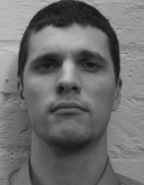
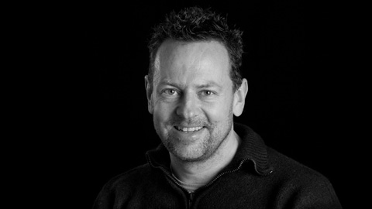



Devetak-Winter rate
$$Rate= \lim_{n→∞}\frac{ℓ_{key}}{n}=H\left(A | E\right)−H(A|B)$$
$H\left(A | E\right)$:
Amount of randomness of Alice that is independent from Eve:
Number of secret bits that Alice and Bob have
$H\left(A | B\right)$:
Amount of uncertainty in Alice’s key from Bob’s POV:
Leakage cost of error-correction

Slide 16
Chronology of QKD
1984-1991: BB84,E91, BBM92
2023
2003:DW Rate
2006
2018-2022
2005
2008

Slide 17
Problems:
Can we trust the measurement devices?
Can we trust the source of entanglement or the quantum channel linking Alice and Bob?
Is it possible to build a protocol independent of the source and the measurements?

Slide 18
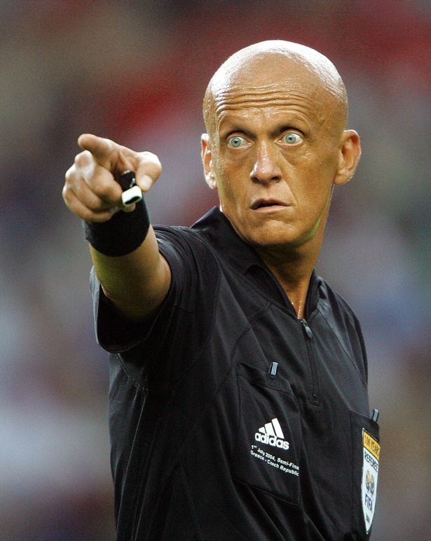




The CHSH game
$$x←\{0,1\}$$
$$y←\{0,1\}$$
$$a∈\{0,1\}$$
$$b∈\{0,1\}$$

Slide 19

The CHSH game
$$x←\{0,1\}$$
$$y←\{0,1\}$$
$$a∈\{0,1\}$$
$$b∈\{0,1\}$$
Alice and Bob win if $x⋅y=a⊕b$
What is the probability Alice and Bob win if they prepare a classical strategy? Quantum strategy can also?

Slide 20


Classical strategy:
Ignore inputs $x,y←\{0,1\}$, reply with $a=b=0$
We always have $a⊕b=0$ so Win with $p_{C}=\frac{3}{4}$
$$x⋅y$$ | 0 | 1
0 | 0 | 0
1 | 0 | 1

Slide 21


Classical strategy:
Quantum strategy:
Ignore inputs $x,y←\{0,1\}$, reply with $a=b=0$
We always have $a⊕b=0$ so Win with $p_{C}=\frac{3}{4}$
Share $\left|00\right\rangle +|11⟩$ and measure with
Can show $p_{Q}=\frac{2+√2}{4}≈0.85$!
$$x⋅y$$ | 0 | 1
0 | 0 | 0
1 | 0 | 1
 | 0 | 1
Alice | $$\{|0⟩,|1⟩\}$$ | $$\{|+⟩,|−⟩\}$$
Bob | $$\{|v_{0}⟩,|v_{1}⟩\}$$ | $$\{|w_{0}⟩,|w_{1}⟩\}$$

Slide 22
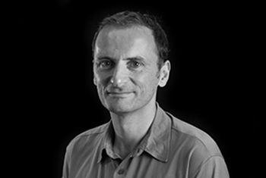
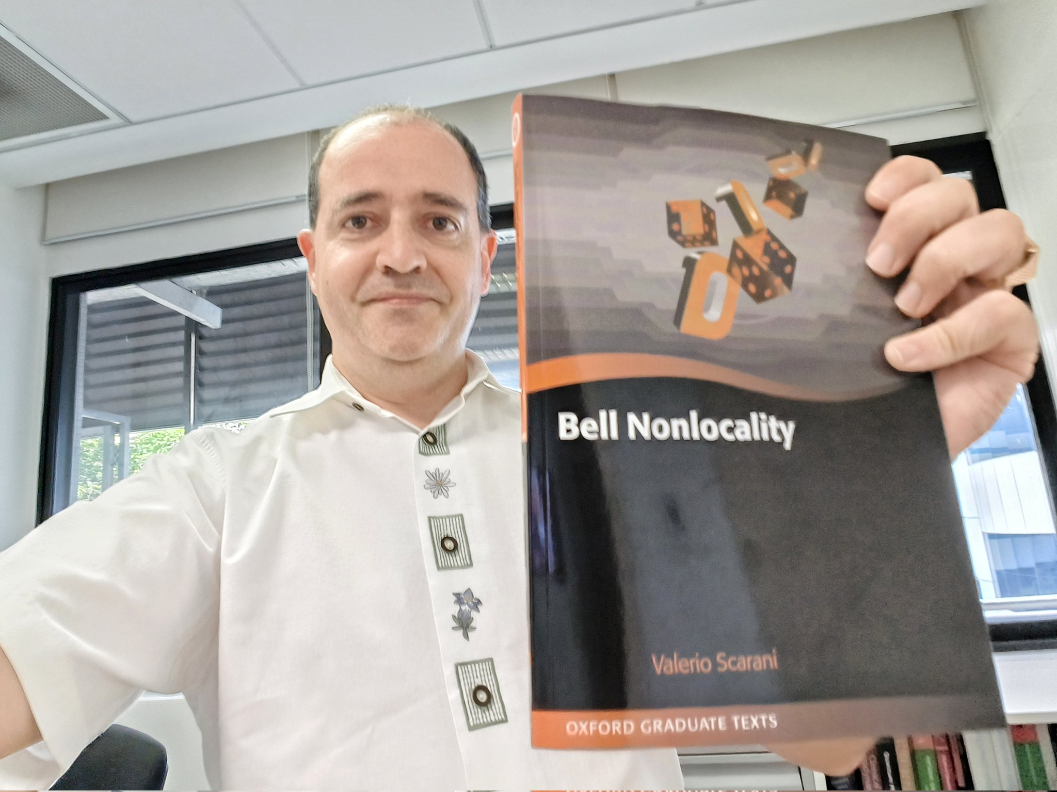
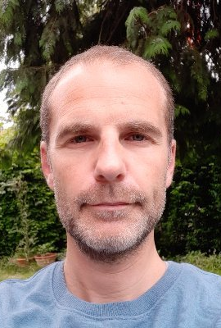


Device-independent QKD from CHSH game:
A QKD protocol that tests the CHSH game, ‘forcing’ the devices to produce $\left|00\right\rangle +|11⟩$ and perform CHSH optimal measurements.
`Ideal/honest’ measurement inputs:
Alice: $\{0,1\}$ for $\{\left|0\right\rangle ,|1⟩\}$ and $\{\left|+\right\rangle ,|−⟩\}$
Bob: $\{0,1,2\}$ for$\{\left|v_{0}\right\rangle ,|v_{1}⟩\}$, $\{\left|w_{0}\right\rangle ,|w_{1}⟩\}$ and $\{\left|0\right\rangle ,|1⟩\}$

Slide 23

Device-independent QKD from CHSH game:
Testing rounds (CHSH rounds):
Alice inputs $X←\{0,1\}$, Bob inputs $Y←\{0,1\}$
Device returns $A∈\{0,1\}$ and $B∈\{0,1\}$
Alice and Bob test $X⋅Y=?A⊕B$

Slide 24

Device-independent QKD from CHSH game:
Testing rounds (CHSH rounds):
Alice inputs $X←\{0,1\}$, Bob inputs $Y←\{0,1\}$
Device returns $A∈\{0,1\}$ and $B∈\{0,1\}$
Alice and Bob test $X⋅Y=?A⊕B$
Key generation rounds:
Alice inputs $X=0$, Bob inputs $Y=2$
Device returns $A∈\{0,1\}$ and $B∈\{0,1\}$

Slide 25

Device-independent QKD from CHSH game:
Testing rounds (CHSH rounds):
Alice inputs $X←\{0,1\}$, Bob inputs $Y←\{0,1\}$
Device returns $A∈\{0,1\}$ and $B∈\{0,1\}$
Alice and Bob test $X⋅Y=?A⊕B$
Key generation rounds:
Alice inputs $X=0$, Bob inputs $Y=2$
Device returns $A∈\{0,1\}$ and $B∈\{0,1\}$
Idea: If $\operatorname{Pr}\left[X⋅Y=A⊕B\right]=ω∈\left(\frac{3}{4},\frac{ 2+√2}{4}\right]$ , then
$$H\left(A | E\right)≥1−h\left(\frac{1}{2}+\frac{1}{2}\sqrt{16ω\left(ω−1\right)+3}\right)$$
So can estimate entropy even if states/measurements are unknown!

Slide 26
Chronology of QKD
1984-1991: BB84,E91, BBM92
2023
2003: D-W Rate
2006:
DIQKD from CHSH
2018-2022
2008
2005

Slide 27
Problems:
Devetak-Winter rate is for infinite number of rounds!
Is key-rate a good security definition?
Von Neumann entropy is an average case measure…
Need a finite, rigorous formalism!

Slide 28

Ideal vs actual protocols
A finite-round QKD protocol produces the classical-quantum state:
$$ρ_{KE}^{actual}=\sum_{k=1}^{2^{ℓ}}{p_{k}|k⟩⟨k|⊗ρ_{E|K=k}}$$

Slide 29

Ideal vs actual protocols
A finite-round QKD protocol produces the classical-quantum state:
$$ρ_{KE}^{actual}=\sum_{k=1}^{2^{ℓ}}{p_{k}|k⟩⟨k|⊗ρ_{E|K=k}}$$
Cryptographic keys should be secret and uniformly random. Ideal QKD protocol produces:
$$ρ_{KE}^{ideal}=\sum_{k=1}^{2^{ℓ}}{\frac{1}{2^{ℓ}}|k⟩⟨k|⊗ρ_{E}}$$

Slide 30

Ideal vs actual protocols
A finite-round QKD protocol produces the classical-quantum state:
$$ρ_{KE}^{actual}=\sum_{k=1}^{2^{ℓ}}{p_{k}|k⟩⟨k|⊗ρ_{E|K=k}}$$
Cryptographic keys should be secret and uniformly random. Ideal QKD protocol produces:
$$ρ_{KE}^{ideal}=\sum_{k=1}^{2^{ℓ}}{\frac{1}{2^{ℓ}}|k⟩⟨k|⊗ρ_{E}}$$
Security is given by ‘comparing’ $ρ_{KE}^{actual}$ with $ρ_{KE}^{ideal}$:
$$‖{ρ_{KE}^{actual}−ρ_{KE}^{ideal}\left.​\right\|}_{Tr}≤ε^{sound}$$

Slide 31

Quick entropy talk --- Advanced
Min entropy:
Given random variable $$X∼\{p_{x}\}_{x∈𝒳}$$
The min-entropy is: $$H_{min}{\left(X\right)}_{p}=−\log{\max_{x}{p_{x}}}$$

Slide 32

Quick entropy talk --- Advanced
Min entropy:
Given random variable $$X∼\{p_{x}\}_{x∈𝒳}$$
The min-entropy is: $$H_{min}{\left(X\right)}_{p}=−\log{\max_{x}{p_{x}}}$$
Quantum min-entropy:
Given classical-quantum state $$ρ_{XE}=\sum_{x}{p_{x}|x⟩⟨x|⊗ρ_{E|x}}$$
The conditional min-entropy is: $$H{\left(X|A\right)}_{ρ}=−\log{p_{guess}\left(X | E\right)},$$
where the ‘guessing probability’
$$p_{guess}\left(X | E\right)=\max_{M_{x}}{\sum_{x}{p_{x}Tr[M_{x}ρ_{E|x}]}}$$

Slide 33
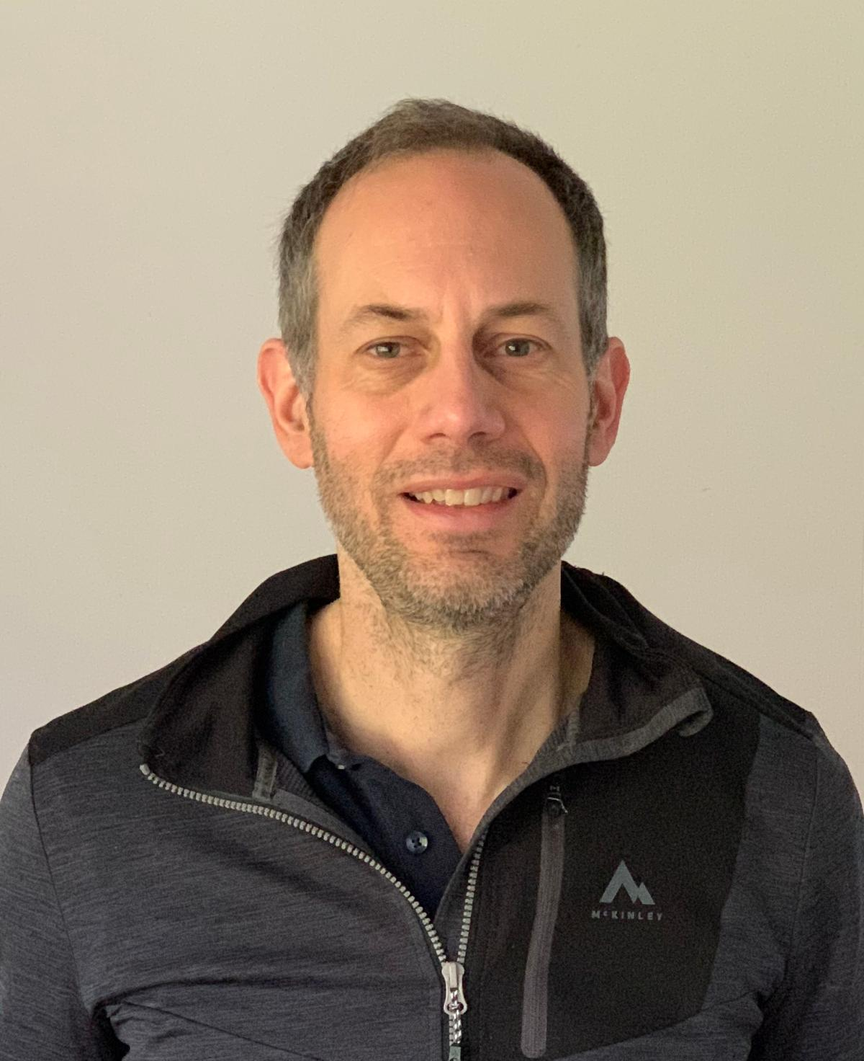
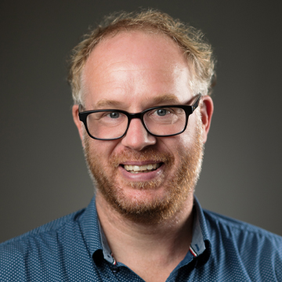

How to prove security/soundness?
After $N$ measurement rounds in a QKD protocol, Alice has raw key ${S=A}_{1}⋯A_{N}$.
Put $S$ through a randomness extractor.
The output key $K$ of length $ℓ$ satisfies:
$$‖{ρ_{KE}^{actual}−τ_{K}⊗ρ_{E}\left.​\right\|}_{Tr}≤2ε+\frac{1}{2}2^{−\left(H_{min}^{ε}\left(S | E\right)−ℓ\right)},$$
where $τ_{K}=\sum{\frac{1}{2^{ℓ}}}|k⟩⟨k|$ is the ‘ideal’ key.

Slide 34
How to prove security/soundness?
After $N$ measurement rounds in a QKD protocol, Alice has raw key ${S=A}_{1}⋯A_{N}$.
Put $S$ through a randomness extractor.
The output key $K$ of length $ℓ$ satisfies:
$$‖{ρ_{KE}^{actual}−τ_{K}⊗ρ_{E}\left.​\right\|}_{Tr}≤2ε+\frac{1}{2}2^{−\left(H_{min}^{ε}\left(S | E\right)−ℓ\right)},$$
where $τ_{K}=\sum{\frac{1}{2^{ℓ}}}|k⟩⟨k|$ is the ‘ideal’ key.
To prove soundness, it suffices to lower bound $H_{min}^{ε}\left(S | E\right)$!

Slide 35
Chronology of QKD
1984-1991: BB84,E91, BBM92
2023
2003: D-W Rate
2006:
DIQKD from CHSH
2018-2022
2008
2005:
Renner Security

Slide 36
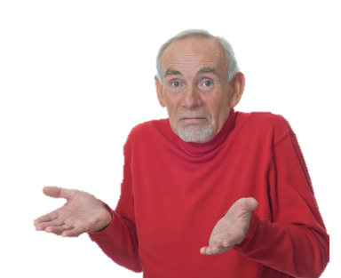
Problems:
Nobody knows how to compute $H_{min}^{ε}\left(S | E\right)$ analytically.
Can we lower bound it?

Slide 37

A quantum AEP
Recall Alice measures $N$ times and obtains raw key $S=A_{1}⋯A_{N}$.
If every measurement round is independent and identical:
$$H_{min}^{ε}\left(A_{1}⋯A_{N} | E_{1}⋯E_{N}\right)≥N⋅H\left(A | E\right)−O\left(\sqrt{N}\right)$$

Slide 38
Chronology of QKD
1984-1991: BB84,E91, BBM92
2023
2003: D-W Rate
2006:
DIQKD from CHSH
2018-2022
2008:
MTom AEP
2005:
Renner Security

Slide 39

Problems:
What if the adversary does not behave identically?
What if the adversary has quantum memory?
Can we lower bound $H_{min}^{ε}\left(S | E\right)$?

Slide 40
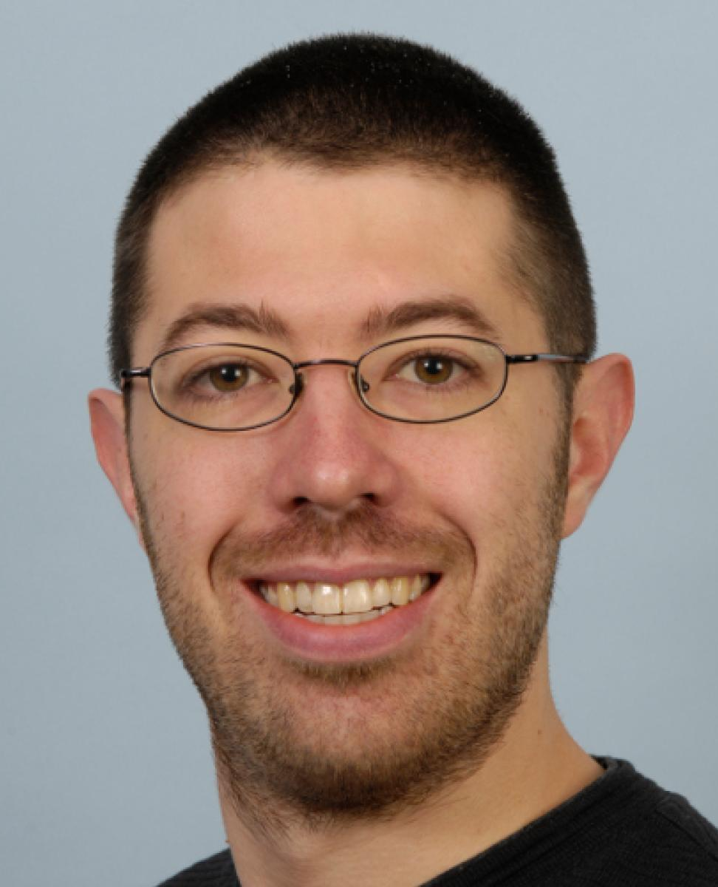
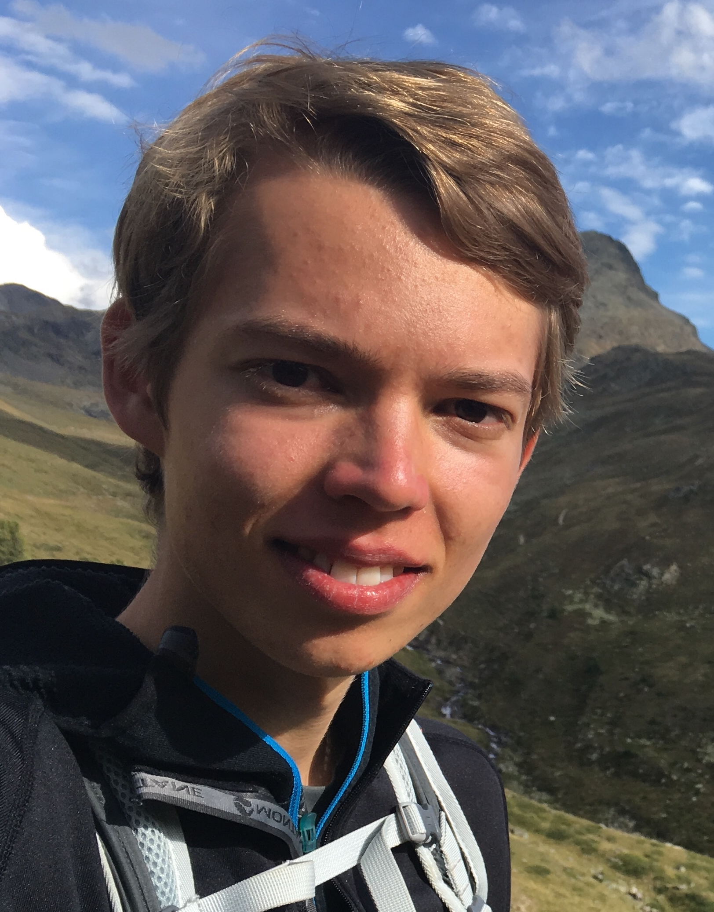
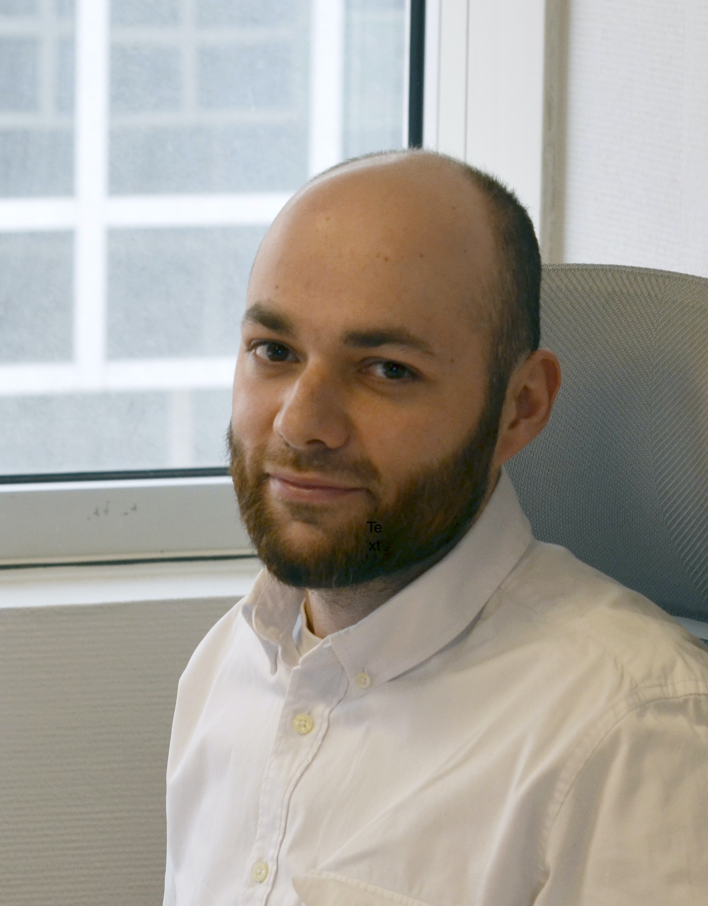

EAT theorems
If the adversary is global but restricted to a Markov chain condition (EAT) or a no-signalling condition (Gen.EAT), then:
$$H_{min}^{ε}\left(A_{1}⋯A_{N} | E\right)≥\sum_{i=1}^{N}{H\left(A_{i} | E\right)}−O\left(\sqrt{N}\right)$$
(more or less)

Slide 41
Chronology of QKD
1984-1991: BB84,E91, BBM92
2023
2003: D-W Rate
2006:
DIQKD from CHSH
2018-2022:
EATs
2008:
MTom AEP
2005:
Renner Security

Slide 42
To do:
Can we generalize to arbitrary games satisfying monogamy-of-entanglement?

Slide 43




The Magic Square game
$$x←\{0,1,2\}$$
$$y←\{0,1,2\}$$
$$a_{0}a_{1}a_{2}∈\{000,011,$$
$$101,110\}$$
$$b_{0}b_{1}b_{2}∈\{001,010,$$
$$100,111\}$$

Slide 44

The Magic Square game
$$x←\{0,1,2\}$$
$$y←\{0,1,2\}$$
$$a_{0}a_{1}a_{2}∈\{000,011,$$
$$101,110\}$$
$$b_{0}b_{1}b_{2}∈\{001,010,$$
$$100,111\}$$
x\y | 0 | 1 | 2
0 | 0
1 | 0 | 1 | 1
2 | 1
Alice and Bob win if $a_{y}=b_{x}$.
Winning probabilities $p_{C},p_{Q}$?

Slide 45

Classical strategy:
Read from a pre-filled square, for example:
Alice, Bob win unless $x=2$ and $y=2$, so $p_{C}=\frac{8}{9}$.
x\y | 0 | 1 | 2
0 | 0 | 0 | 0
1 | 0 | 0 | 0
2 | 1 | 1 | x

Slide 46


Classical strategy:
Quantum strategy:
Share ${\left(\left|00\right\rangle +|11⟩\right)}_{A_{1}B_{1}A_{2}B_{2}}^{⊗2}$and measure with
Can show $p_{Q}=1$!
Read from a pre-filled square, for example:
Alice, Bob win unless $x=2$ and $y=2$, so $p_{C}=\frac{8}{9}$.
x\y | 0 | 1 | 2
0 | 0 | 0 | 0
1 | 0 | 0 | 0
2 | 1 | 1 | x
x\y | 0 | 1 | 2
0 | $$I⊗Z$$ | $$Z⊗I$$ | Z$⊗Z$
1 | $$X⊗I$$ | $$I⊗X$$ | $$X⊗X$$
2 | $$−X⊗Z$$ | $$−Z⊗X$$ | $$Y⊗Y$$

Slide 47
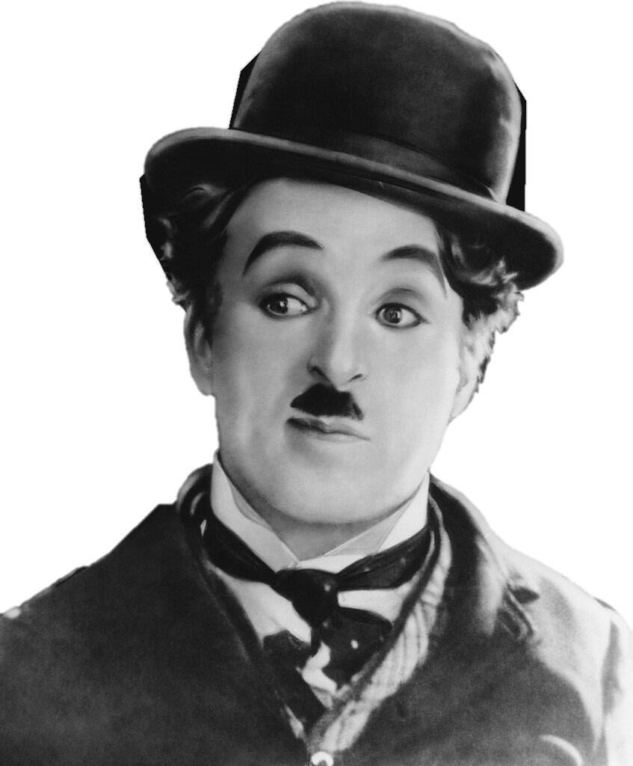






The tripartite Magic Square game
$$x←\{0,1,2\}$$
$$a_{0}a_{1}a_{2}∈\{000,011,101,110\}$$
$$y←\{0,1,2\}$$
$$b_{0}b_{1}b_{2}∈\{001,010,100,111\}$$
$$(x,y)$$
$$c∈\{0,1\}$$

Slide 48


The tripartite Magic Square game
$$x←\{0,1,2\}$$
Alice and Bob and Charlie win if $a_{y}=b_{x}$ and $a_{y}=c$.
Winning probabilities $p_{C},p_{Q}$?
$$a_{0}a_{1}a_{2}∈\{000,011,101,110\}$$
$$y←\{0,1,2\}$$
$$b_{0}b_{1}b_{2}∈\{001,010,100,111\}$$
Using same classical strategy: $p_{C}=\frac{8}{9}$.
Quantumly: $p_{Q}=?\frac{8}{9}$
$$(x,y)$$
$$c∈\{0,1\}$$

Slide 49

The tripartite Magic Square game
$$x←\{0,1,2\}$$
Alice and Bob and Charlie win if $a_{y}=b_{x}$ and $a_{y}=c$.
Winning probabilities $p_{C},p_{Q}$?
$$a_{0}a_{1}a_{2}∈\{000,011,101,110\}$$
$$y←\{0,1,2\}$$
$$b_{0}b_{1}b_{2}∈\{001,010,100,111\}$$
Using same classical strategy: $p_{C}=\frac{8}{9}$.
Quantumly: $p_{Q}=\frac{8.0}{9}$
$$(x,y)$$
$$c∈\{0,1\}$$

Slide 50

The tripartite Magic Square game
$$x←\{0,1,2\}$$
Alice and Bob and Charlie win if $a_{y}=b_{x}$ and $a_{y}=c$.
Winning probabilities $p_{C},p_{Q}$?
$$a_{0}a_{1}a_{2}∈\{000,011,101,110\}$$
$$y←\{0,1,2\}$$
$$b_{0}b_{1}b_{2}∈\{001,010,100,111\}$$
Using same classical strategy: $p_{C}=\frac{8}{9}$.
Quantumly: $p_{Q}=\frac{8.00}{9}$
$$(x,y)$$
$$c∈\{0,1\}$$

Slide 51

The tripartite Magic Square game
$$x←\{0,1,2\}$$
Alice and Bob and Charlie win if $a_{y}=b_{x}$ and $a_{y}=c$.
Winning probabilities $p_{C},p_{Q}$?
$$a_{0}a_{1}a_{2}∈\{000,011,101,110\}$$
$$y←\{0,1,2\}$$
$$b_{0}b_{1}b_{2}∈\{001,010,100,111\}$$
Using same classical strategy: $p_{C}=\frac{8}{9}$.
Quantumly: $p_{Q}=\frac{8.000}{9}$
$$(x,y)$$
$$c∈\{0,1\}$$

Slide 52

The tripartite Magic Square game
$$x←\{0,1,2\}$$
Alice and Bob and Charlie win if $a_{y}=b_{x}$ and $a_{y}=c$.
Winning probabilities $p_{C},p_{Q}$?
$$a_{0}a_{1}a_{2}∈\{000,011,101,110\}$$
$$y←\{0,1,2\}$$
$$b_{0}b_{1}b_{2}∈\{001,010,100,111\}$$
Using same classical strategy: $p_{C}=\frac{8}{9}$.
Quantumly: $p_{Q}=\frac{8.0005}{9}$
$$(x,y)$$
$$c∈\{0,1\}$$

Slide 53

The tripartite Magic Square game
$$x←\{0,1,2\}$$
Alice and Bob and Charlie win if $a_{y}=b_{x}$ and $a_{y}=c$.
Winning probabilities $p_{C},p_{Q}$?
$$a_{0}a_{1}a_{2}∈\{000,011,101,110\}$$
$$y←\{0,1,2\}$$
$$b_{0}b_{1}b_{2}∈\{001,010,100,111\}$$
Using same classical strategy: $p_{C}=\frac{8}{9}$.
Quantumly: $p_{Q}=\frac{8.00057}{9}$
$$(x,y)$$
$$c∈\{0,1\}$$

Slide 54


We can make a DI protocol out of this!
Alice selects $X←\left\{0,1,2\right\}$
Receives $A∈\{000,011,101,110\}$
Bob selects $Y←\left\{0,1,2\right\}$
Receives $B∈\{001,010,100,111\}$

Slide 55

We can make a DI protocol out of this!
Alice selects $X←\left\{0,1,2\right\}$
Receives $A∈\{000,011,101,110\}$
Bob selects $Y←\left\{0,1,2\right\}$
Receives $B∈\{001,010,100,111\}$
After $N$ rounds Alice and Bob share $X_{1}⋯X_{N}$ and $Y_{1}⋯Y_{N}$
Alice’s raw key is $S_{A}=A_{1}(Y_{1})⋯A_{N}(Y_{N})$ and Bob’s is $B_{1}(X_{1})⋯B(X_{N})$

Slide 56

We can make a DI protocol out of this!
Alice selects $X←\left\{0,1,2\right\}$
Receives $A∈\{000,011,101,110\}$
Bob selects $Y←\left\{0,1,2\right\}$
Receives $B∈\{001,010,100,111\}$
After $N$ rounds Alice and Bob share $X_{1}⋯X_{N}$ and $Y_{1}⋯Y_{N}$
Alice’s raw key is $S_{A}=A_{1}(Y_{1})⋯A_{N}(Y_{N})$ and Bob’s is $B_{1}(X_{1})⋯B(X_{N})$
To show security need to bound
$$H_{min}^{ε}\left(S_{A} | E\right)≥NH\left(A\left(Y\right) | E\right)−O(\sqrt{N})$$
Suffices to bound the entropy of each round $NH\left(A\left(Y\right) | E\right)$!

Slide 57

Entropy of the raw key?
Alice and Bob estimate $\operatorname{Pr}{[A\left(Y\right)=B\left(X\right)]}=ω_{2}∈\left(\frac{8}{9},1\right]$
Recall $\operatorname{Pr}\left[A\left(Y\right)=B\left(X\right)=C\right]=ω_{3}∈\left[\frac{8}{9},\frac{8.00057}{9}\right]$, we have:

Slide 58



Entropy of the raw key?
Alice and Bob estimate $\operatorname{Pr}{[A\left(Y\right)=B\left(X\right)]}=ω_{2}∈\left(\frac{8}{9},1\right]$
Recall $\operatorname{Pr}\left[A\left(Y\right)=B\left(X\right)=C\right]=ω_{3}∈\left[0,\frac{8}{9} \right]$, we have:
$$\operatorname{Pr}{[G_{E}^{c}|W_{AB}]}=\frac{\operatorname{Pr}\left[G_{E}^{c}∧W_{AB}\right]}{Pr⁡[W_{AB}]}≤\frac{\operatorname{Pr}\left[G_{E}^{c}\right]}{ω_{2}},$$
$G_{E}=$ Eve guesses correctly
$W_{AB}=$ Alice and Bob win

Slide 59

Entropy of the raw key?
Alice and Bob estimate $\operatorname{Pr}{[A\left(Y\right)=B\left(X\right)]}=ω_{2}∈\left(\frac{8}{9},1\right]$
Recall $\operatorname{Pr}\left[A\left(Y\right)=B\left(X\right)=C\right]=ω_{3}∈\left[\frac{8}{9},\frac{8.00057}{9}\right]$, we have:
$$\operatorname{Pr}{[G_{E}^{c}|W_{AB}]}=\frac{\operatorname{Pr}\left[G_{E}^{c}∧W_{AB}\right]}{Pr⁡[W_{AB}]}≤\frac{\operatorname{Pr}\left[G_{E}^{c}\right]}{ω_{2}},$$
$$\operatorname{Pr}\left[G_{E}\right]≤1−ω_{2}+\operatorname{Pr}\left[G_{E}∧W_{AB}\right]≤1−ω_{2}+ω_{3}$$
$G_{E}=$ Eve guesses correctly
$W_{AB}=$ Alice and Bob win

Slide 60

Entropy of the raw key?
Alice and Bob estimate $\operatorname{Pr}{[A\left(Y\right)=B\left(X\right)]}=ω_{2}∈\left(\frac{8}{9},1\right]$
Recall $\operatorname{Pr}\left[A\left(Y\right)=B\left(X\right)=C\right]=ω_{3}∈\left[\frac{8}{9},\frac{8.00057}{9}\right]$, we have:
$$\operatorname{Pr}{[G_{E}^{c}|W_{AB}]}=\frac{\operatorname{Pr}\left[G_{E}^{c}∧W_{AB}\right]}{Pr⁡[W_{AB}]}≤\frac{\operatorname{Pr}\left[G_{E}^{c}\right]}{ω_{2}},$$
$$\operatorname{Pr}\left[G_{E}\right]≤1−ω_{2}+\operatorname{Pr}\left[G_{E}∧W_{AB}\right]≤1−ω_{2}+ω_{3}$$
$$⇒H_{min}\left(A\left(Y\right) | E\right)=−\log{p_{guess}\left(A\left(Y\right) | E\right)} \\ =−\log{Pr⁡[G_{E}]} \\ =−\log{(1−ω_{2}+ω_{3})}$$
$G_{E}=$ Eve guesses correctly
$W_{AB}=$ Alice and Bob win

Slide 61
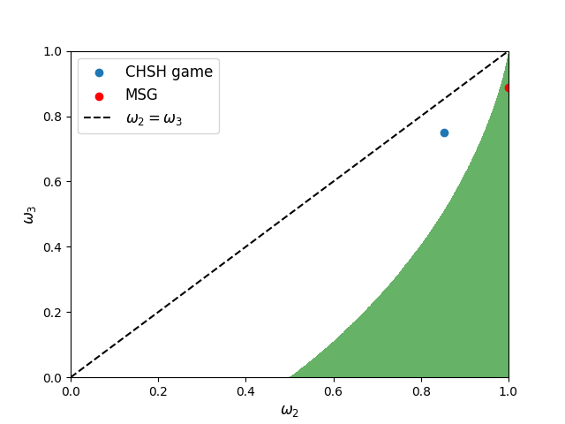

What does it mean?
Range of $ω_{2},ω_{3}$ with positive Devetak-Winter rate
Finite key rates for MSG

Slide 62
Chronology of QKD
1984-1991: BB84,E91, BBM92
2023:
CT23
2003: D-W Rate
2006:
DIQKD from CHSH
2018-2022:
EATs
2008:
MTom AEP
2005:
Renner Security

